Slide 1
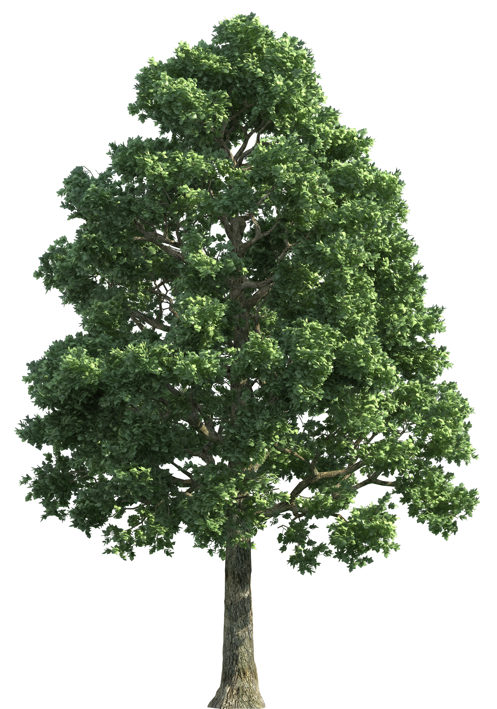
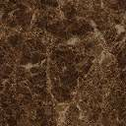
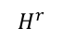
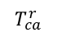
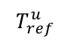
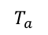
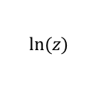
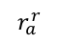
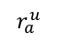
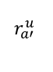
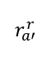
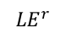
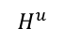
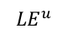
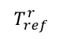
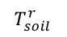
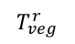
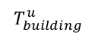
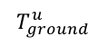
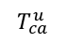
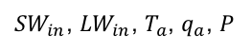
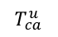
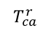
${SW}_{in}$, ${LW}_{in}$, $T_{a}$, $q_{a}$, $P$
$$ln⁡(z)$$
$$T_{a}$$
$$r_{a′ }^{r}$$
$$r_{a′ }^{u}$$
$$r_{a}^{r}$$
$$r_{a}^{u}$$
$$T_{ref}^{r}$$
$$T_{ref}^{u}$$
$$T_{ref}^{u}$$
$$T_{ref}^{r}$$
$$H^{r}$$
$${LE}^{r}$$
$${LE}^{u}$$
$$H^{u}$$
$$T_{ca}^{r}$$
$$T_{building}^{u}$$
$$T_{ca}^{u}$$
$$T_{ca}^{u}$$
$$T_{ca}^{r}$$
$$T_{veg}^{r}$$
$$T_{soil}^{r}$$
$$T_{ground}^{u}$$
T

Slide 2
